Slide 1
MultiBlocks
By Kostiantyn Makrasnov
& Keenan Robinson

Slide 2
Primary Goals
Multiplayer Functionality (Competition)
Customizable Characters
Level Disintegration
Unique Game Mechanics / Mission

Slide 3




Used Resources/Tools
Unity 2018.3f1
Blender v2.79
Photoshop CC 2019
Visual Studio
GitHub (Desktop)
Asset Store

Slide 4
Completed Features
Keenan:
Player Movement | Camera Movement | 3D Models
Kostiantyn: Multiplayer System | Level Generation | Player Customization

Slide 5
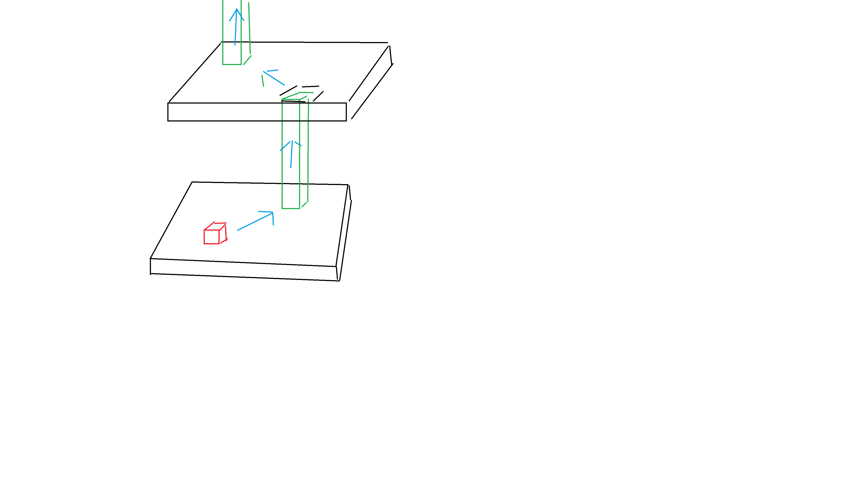
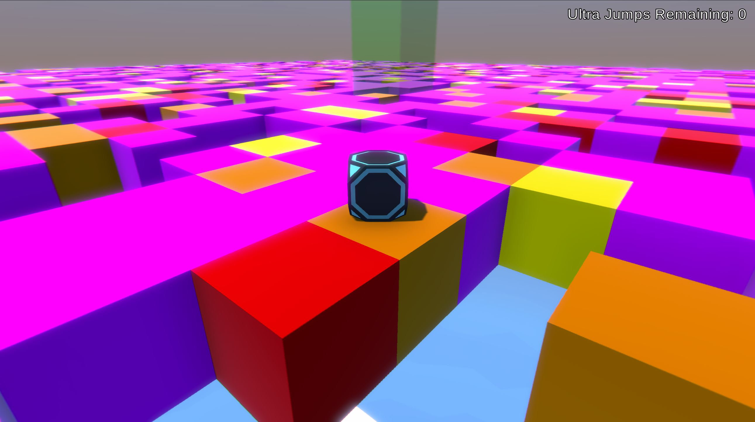
How it Works?

Slide 6
Multiplayer System
Client/Server Model (Unity LLAPI)

Slide 7
SERVER
OnConnect|Bob
NewUser|Bob
NewUser|Bob
Bob
Bill
Fred
Clients

Slide 8
Multiplayer System
Client/Server Model (Unity LLAPI)
Packet Format and Parsing

Slide 9
Packet Format and Parsing
Example Message:
“OnPlayerMove|Bob,12.13,634.23,1.45|Bill, 96.63,434.63,87.95”
After Initial Parse (Delimiter “|”):
data[0] - “OnPlayerMove” (Used as Key in a Methods Map)
data[1] - “Bob,12.13,634.23,1.45”
data[2] - “Bill,96.63,434.63,87.95”
After Second Parse (Delimiter “,”):
curPlayer[0] - “Bob” (Player Name)
curPlayer[1] - “12.13” (X position)
…

Slide 10
Multiplayer System
Client/Server Model (Unity LLAPI)
Packet Format and Parsing
Player Syncronization

Slide 11
Level Generation
Level Timing System
Map of Level Settings
Stack of Cubes to Despawn
Pooling System for Level Tiles
Animation Fail – But WHY?

Slide 12
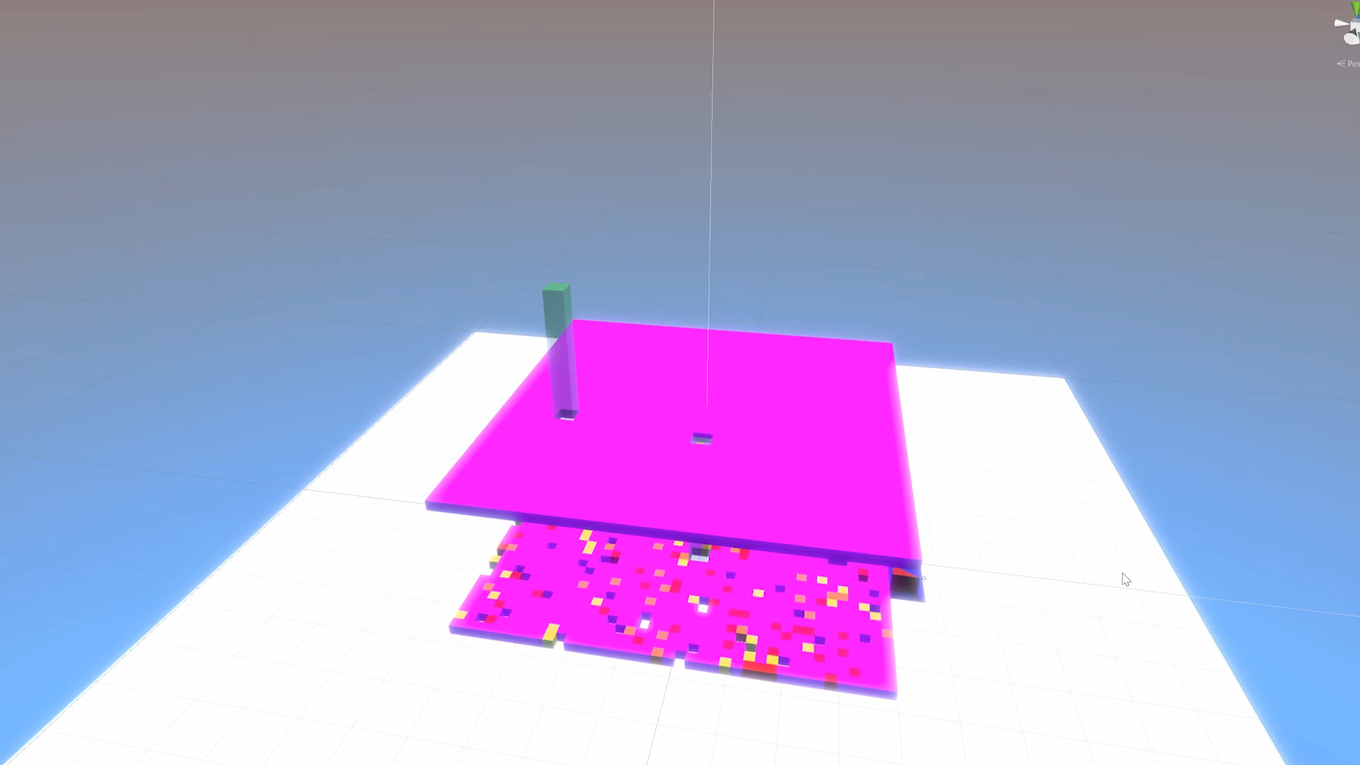
Multi-stage Disitegration
In/out Elevators Placement
Timing, Locations and Materials SYNCRONIZED

Slide 13
Player Customization
Player Input (Name, Model and Ready)
Ready Message Journey
Storage of User Settings
Components tailored at the end
Body Gameobject
Nametag

Slide 14
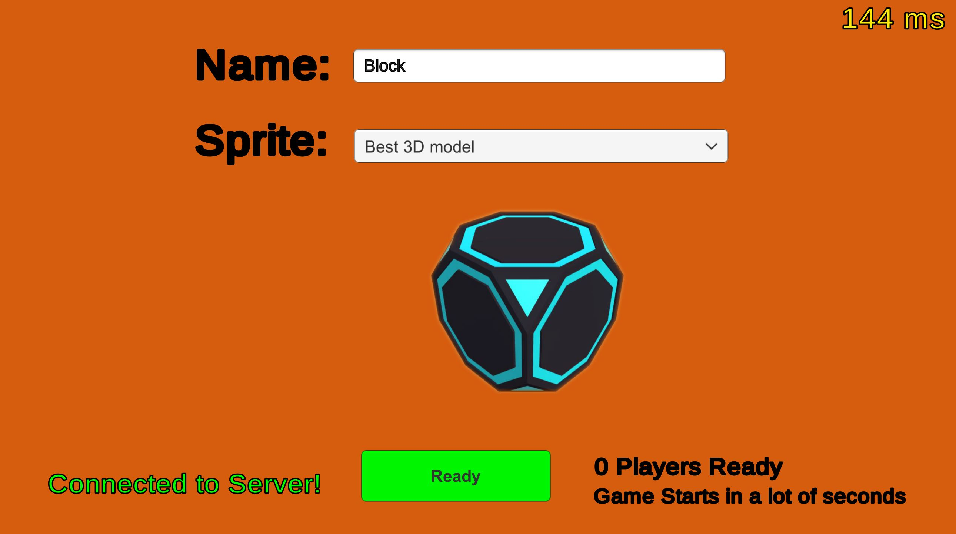
Player Customization
Player Input
Ready Message Journey
Storage of User Settings
Components tailored at the end
Body Gameobject
Nametag

Slide 15
Lessons Learned
Tile worlds + animations = CPU No Bueno
Multiplayer game = 2x work
Implementation of player synchronization
Importance of object pooling

Slide 16

Now for the
DEMO
GO TO CS1 and then…

Slide 17
CREDITS
Questions?
Special thanks to all the people who made and released these awesome resources for free:
Presentation template by SlidesCarnival
Photographs by Unsplash

